Slide 1
STRINGS (String Operations)
LESSON 4

Slide 2
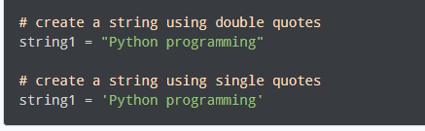
PYTHON STRINGS
In computer programming, a string is a sequence of characters.
For example, "hello" is a string containing a sequence of characters 'h', 'e', 'l', 'l', and 'o'.
We use single quotes or double quotes to represent a string in Python. For example,

Slide 3
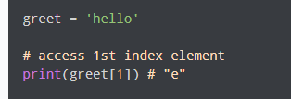
PYTHON STRINGS
Access String Characters in Python
We can access the characters in a string in three ways.
Indexing: One way is to treat strings as a list and use index values. For example,

Slide 4
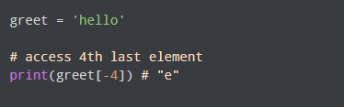
PYTHON STRINGS
Access String Characters in Python
Negative Indexing: Similar to a list, Python allows negative indexing for its strings. For example:

Slide 5
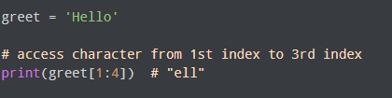
PYTHON STRINGS
Access String Characters in Python
Slicing: Access a range of characters in a string by using the slicing operator colon :. For example,

Slide 6
PYTHON STRINGS
Access String Characters in Python
Note: If we try to access an index out of the range or use numbers other than an integer, we will get errors.

Slide 7

PYTHON STRINGS
Python Strings are immutable
In Python, strings are immutable. That means the characters of a string cannot be changed. For example,

Slide 8
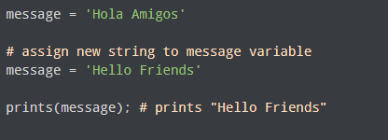
PYTHON STRINGS
We can Assign New String to String Variable

Slide 9
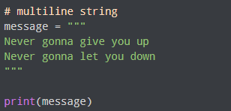
PYTHON STRINGS
Python Multiline String
We can also create a multiline string in Python. For this, we use triple double quotes """ or triple single quotes '''. For example,

Slide 10
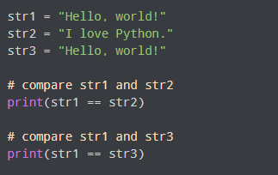
PYTHON STRINGS
Python String Operations
There are many operations that can be performed with strings which makes it one of the most used data types in Python.
1. Compare Two Strings
We use the == operator to compare two strings. If two strings are equal, the operator returns True. Otherwise, it returns False. For example,

Slide 11
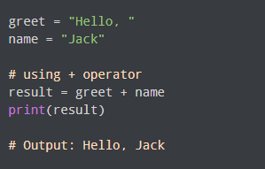
PYTHON STRINGS
Python String Operations
2. Join Two or More Strings
In Python, we can join (concatenate) two or more strings using the + operator.

Slide 12
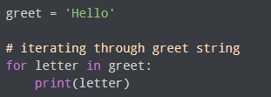
PYTHON STRINGS
Iterate through a String
We can iterate through a string using a for loop. For example,

Slide 13
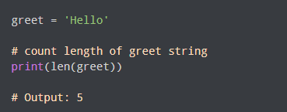
PYTHON STRINGS
String Length
In Python, we use the len() method to find the length of a string. For example,

Slide 14

PYTHON STRINGS
Membership Test
We can test if a substring exists within a string or not, using the keyword in.

Slide 15
PYTHON STRINGS
Formatting Python Strings
There are four different ways to perform string formatting in Python:
Formatting with % Operator.
Formatting with format() string method.
Formatting with string literals, called f-strings.
Formatting with String Template Class

Slide 16
PYTHON STRINGS
Using % operator
It is the oldest method of string formatting. Here we use the modulo % operator. The modulo % is also known as the “string-formatting operator”.
print(“Glad to see you in the %s today." %‘you')

Slide 17
PYTHON STRINGS
Multiple strings using % operator
name = ‘Jack' print(" %s is coding in %s "%(‘python',name))
‘%s’ is used to inject strings similarly ‘%d’ for integers, ‘%f’ for floating-point values, ‘%b’ for binary format. For all formats, conversion methods visit the official documentation.
variable = 12
string = "Variable as integer = %d \n\
Variable as float = %f" %(variable, variable)
print (string)

Slide 18
PYTHON STRINGS
format() function
Format() method was introduced with Python3 for handling complex string formatting more efficiently.
Formatters work by putting in one or more replacement fields and placeholders defined by a pair of curly braces { } into a string and calling the str.format().
The value we wish to put into the placeholders and concatenate with the string passed as parameters into the format function.

Slide 19
PYTHON STRINGS
format() function
print('We all are {}.'.format('equal'))
print('{2} {1} {0}'.format('directions', ’the', 'Read'))
print('a: {a}, b: {b}, c: {c}'.format(a = 1, b = 'Two', c = 12.3))

Slide 20
PYTHON STRINGS
format() function
name = 'Ele'
print(f"My name is {name}.")

Slide 21
PYTHON STRINGS
format() function for floating point
print('The value of pi is: %1.5f' %3.141592)
# vs.
print('The value of pi is: {0:1.5f}'.format(3.141592))

Slide 22
PYTHON STRINGS
Change case
# working of upper() function
text = Python Programming Class'
# upper() function to convert
# string to upper case
print("\nConverted String:")
print(text.upper())
# lower() function to convert
# string to lower case
print("\nConverted String:")
print(text.lower())
# title() function to convert
# string to title case
print("\nConverted String:")
print(text.title())

Slide 23
PYTHON STRINGS
lstrip() and rstrip()
string = “ Python Programming Class ”
# lstrip()
print("Removed left whitespace:")
print(string.lstrip())
# rstrip()
print("Removed right whitespace:")
print(string.rstrip())

Slide 24
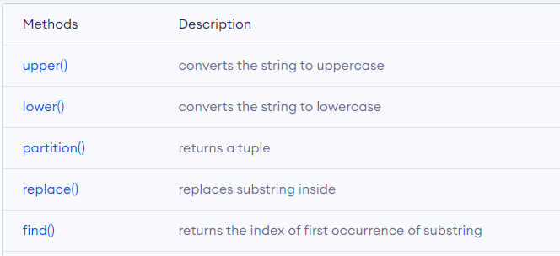
PYTHON STRINGS
Methods
Besides those mentioned above, there are various string methods present in Python. Here are some of those methods:

Slide 25
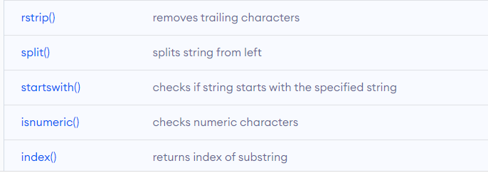
PYTHON STRINGS
Methods

